Slide 1

Stock Predictions
To Bull Or To Bear?

Slide 2

PROJECT OVERVIEW
Stock Predictions
MACHINE LEARNING
Buy, Sell or Hold?
Using Yahoo! Finance API Published To Azure Web Service
SVR Algorithm
Accuracy Model
VISUALIZATIONS
SENTIMENT ANALYSIS
AI Stock Analysis Using Tableau
Percentage Trend Using NLTK News API Library

Slide 3

PROJECT TEAM
About
Soo Bin Im
Meardreed Vilmeus
Max Young
Priya Jain
GitHub Repository
https://github.com/priyajainnyc/final-group-project-4-azure

Slide 4

AI STOCK PREDICTIONS
BUY
HOLD
SELL
25 Buy Recommendations with Total Market Cap of $14.56B
26 Hold Recommendations with Total Market Cap of $2.34B
21 Sell Recommendations with Total Market Cap of $580M

Slide 5

DEPENDENCIES
Pandas
Python
HTML
CSS
Numpy
Scikit-learn
Dash
Flask
NLTK Library
Yahoo! Finance API
Finwiz Data
Tableau
Azure Web Services

Slide 6

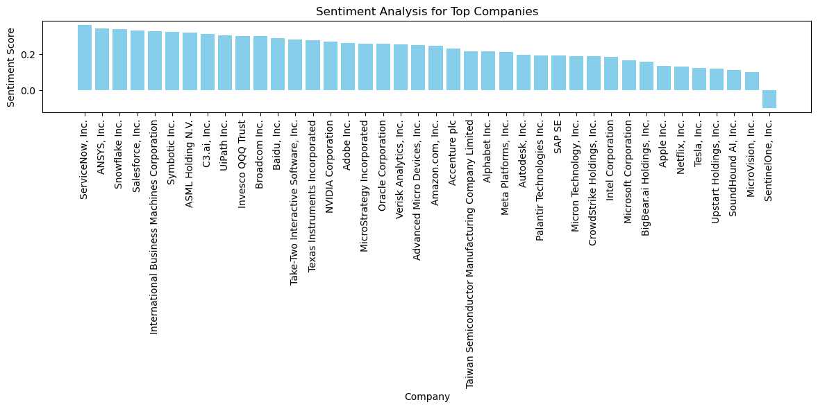
COMPANY OVERVIEW

Slide 7

Thank You
Questions?

Slide 8

PROJECT DESCRIPTION
Stock Prediction Web Application Using Dash and SVR Machine Learning
This project aims to provide a simple yet effective tool for stock market investors to visualize company stock data and make predictions based on machine learning models.
The web application is built using the dash framework, a python library for building web applications with interactive user interfaces.

Slide 9

VISUALIZATIONS
AI Stock AnalysiS
We've provided the below listed visualizations for AI specific stock data pulled from Finviz in a Tableau dashboard as well as a sentiment analysis from the nltk library data:

Slide 10

GROWTH STRATEGY
How we’ll scale in the future
FEB 20XX
MAY 20XX
OCT 20XX
Roll out product to local businesses to help establish the product
Release the product to the general public and monitor stock market trends
Gather feedback from the financial community to expand availability of the product

Slide 11

SUMMARY
At Contoso, we believe in giving 110%. By closing the loop on investment management and using the latest technology, we help businesses grow and expand their portfolio funds. We thrive because of our market knowledge and a great team behind our product. As our CEO says, "Efficiencies will come from proactively transforming how we do business."

